Slide 1

HR51 PROPERTIES
2
+
2
+
YOUR DREAM COMES TRUE

Slide 2

OBJECTIVE
2
+
Real estate refers to property consisting of land, buildings, and other structures, along with the natural resources and assets that are associated with it.
The aim of this project is to develop a real estate system. This is a basic system where users can register then login and view property. The whole system will be managed by the admin also it give the facilitation to the users to communicate with each other and admin can have all these details in his personal machine rather than having hundreds of registers.
Real Estate Management System is to manage the details of Property, Property Type, Property Details, Location. It manages all the information about Property, Facility, Location, Property.

Slide 3
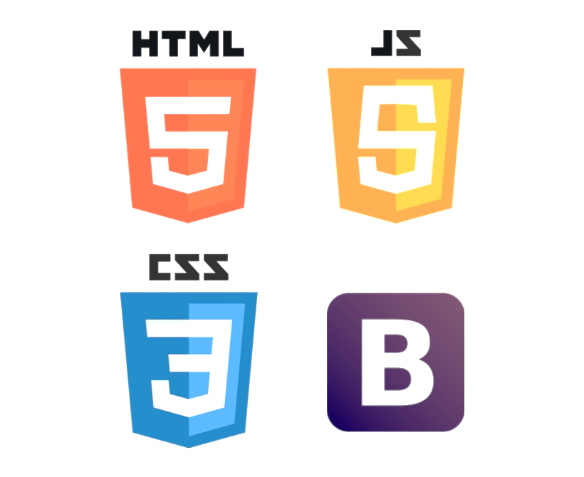


TECH STACK
DJANGO + BOOTSTRAP
BENEFITS
Frontend:
Database:
Backend:
Increased online visibility and brand recognition
Engaging user experience leading to higher conversion rates
Streamlined property management and listing updates
Enhanced lead generation and customer engagement
Improved search engine optimization (SEO) for better organic rankings
Advanced analytics and reporting for data-driven decision-making

Slide 4

HR51 PROPERTIES
KEY FEATURES
ADMIN
Property Listings: Our platform enables agents to create comprehensive property listings with detailed descriptions, high-quality images, appointment, and interactive maps. This feature ensures that buyers can easily access all relevant information about a property in one place.
Role: The admin user has administrative privileges and controls the overall functioning of the application.
Features: The admin should have access to features such as user management, content management, and staff management.

Slide 5

HR51 PROPERTIES
USER
STAFF
Users can search for properties based on various criteria such as location, Area, etc. It retrieves and displays relevant property listings.
Users can view detailed information about a specific property. It provides property descriptions, images, pricing details, and contact information for inquiries.
Users can contact the staff or property owner through the website. It enables users to send inquiries, schedule appointments, or request additional information about a property
Staff members can manage their assigned property listings. They can add new properties, edit property details, update availability status, and view inquiries related to their listings.
Staff members can schedule and manage property viewings and appointments with clients.

Slide 6
Future Development
2
+
Our real estate project is an evolving platform, and we have plans to enhance its capabilities further. Future developments include integrating artificial intelligence for property recommendations, 3D View of Property, and Property Price Prediction.
HR51 PROPERTIES

Slide 7
THANK YOU
2
+
2
+
HR51 PROPERTIES

